Slide 1


Slide 2

Research Computing and Data Services
We're here to help after the workshop!
quest-help@northwestern.edu
bit.ly/rcdsconsult
https://sites.northwestern.edu/researchcomputing/

Slide 3
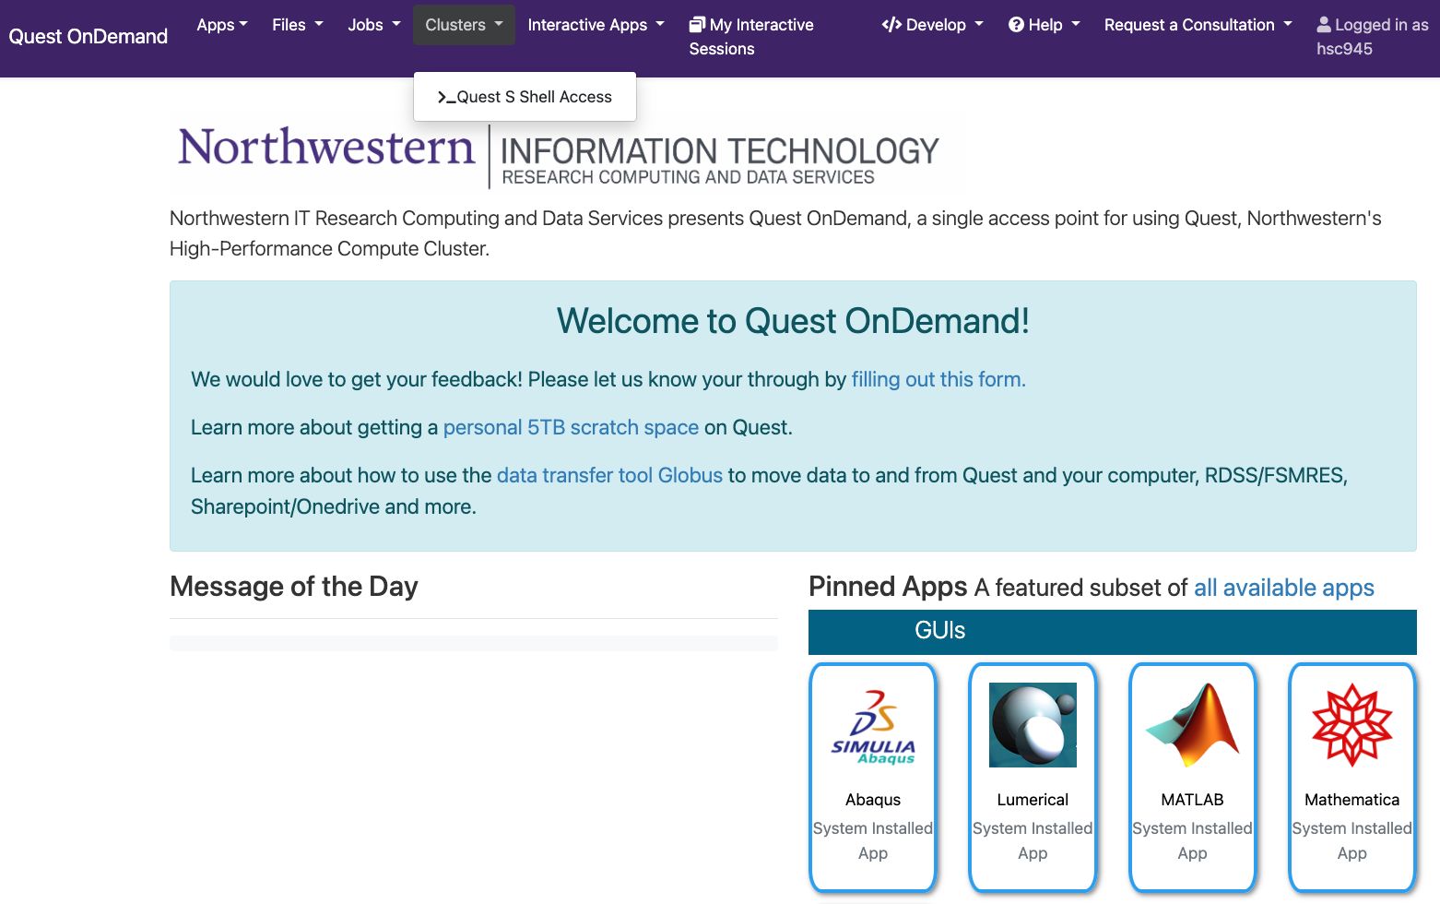
qondemand.ci.northwestern.edu

Slide 4
In the terminal tab that opens...
move to our classroom folder
cd /projects/e32559
make your own subfolder if you haven’t already
mkdir <folder_name>

Slide 5
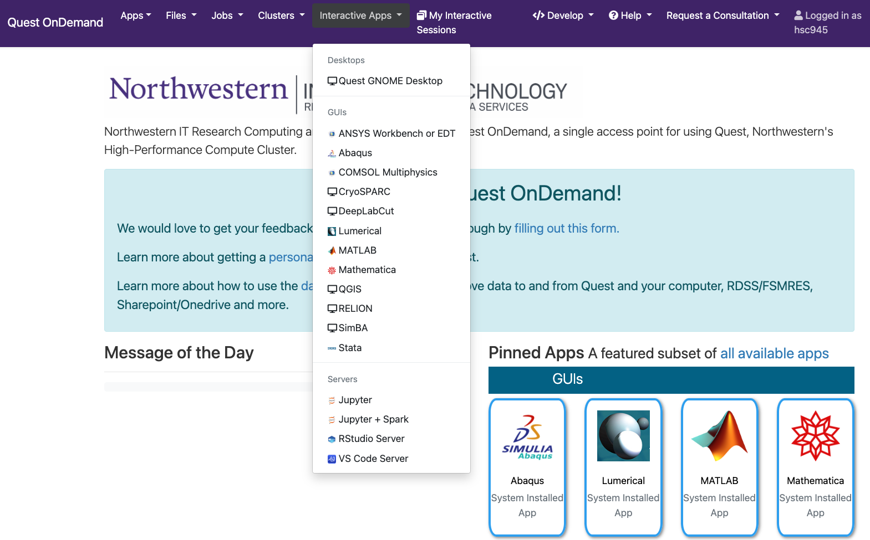
qondemand.ci.northwestern.edu

Slide 6
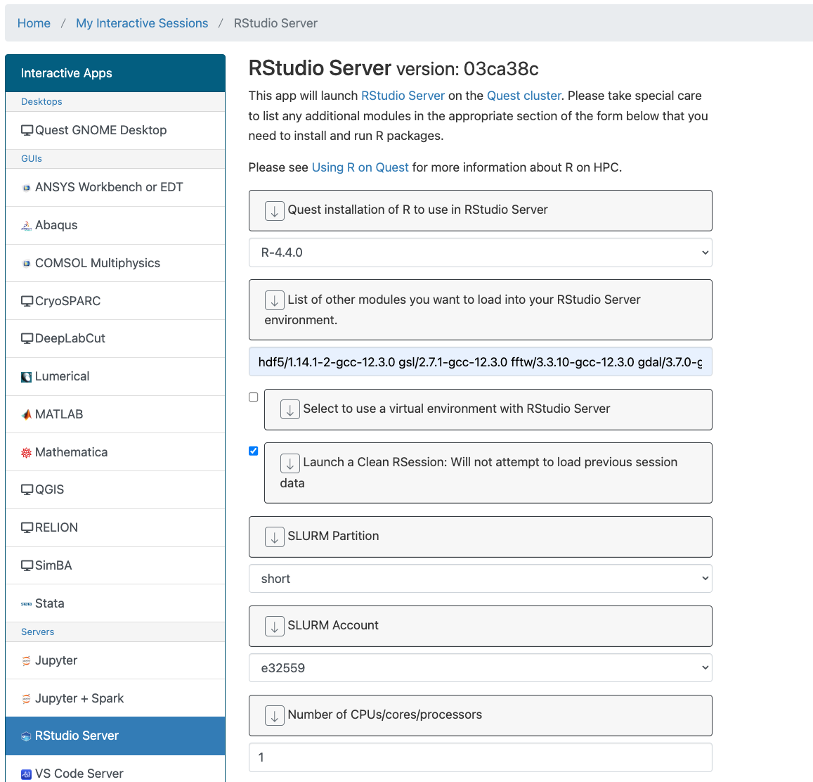
Quest OnDemand link: qondemand.ci.northwestern.edu R version: 4.4.0 Additional modules: hdf5/1.14.1-2-gcc-12.3.0 gsl/2.7.1-gcc-12.3.0 fftw/3.3.10-gcc-12.3.0 gdal/3.7.0-gcc-12.3.0 nlopt/2.7.1-gcc-12.3.0 Accout: e32559 CPU: 1 Time: 1 hour Memory: 3

Slide 7
Why these additional modules?
sometimes R packages use software in addition to R as dependencies
for example:
hdf5r is an R package for linking to HDF5 binary data format so it also needs the software for HDF5 data formats
nloptr is an R package that interfaces with NLopt software for non-linear optimization, so it also needs the NLopt software available
If you install an R package and get an error about missing files that are named something like libssl.so, or being unable to link to something that usually means you’re missing some dependent software.

Slide 8
R packages
# load packages
library(Seurat)
library(SeuratData)
library(SeuratWrappers)
library(Azimuth)
library(ggplot2)
library(patchwork)
# now I can do analyses!
base R has a lot of built in and useful functions
many people write packages with additional functions for specific analyses/tasks
for example, tidyverse
first step is often to load necessary packages into your environment (or to install them)

Slide 9
install.packages() vs library()
install.packages(), or other install commands, downloads and installs the desired package from the internet to your computer
library() loads a package that is already installed on your computer to your active software environment
You can only use the functions in your active software environment!
select(tibble, column1, column2) # error
library(dplyr)
select(tibble, column1, column2) # works!

Slide 10
Where do R packages go when you install?
install.packages() will use the output of .libPaths() to determine where to install packages
by default, it knows about
where the version of R you’re using was installed
and your home directory
Run .libPaths() in your console to see these paths.

Slide 11
.libPaths()
[1] "/home/hsc945/R/x86_64-pc-linux-gnu-library/4.4”
[2] "/hpc/software/spack_v20d1/spack/opt/spack/linux-rhel7-x86_64/gcc-12.3.0/r-4.4.0-aaqsqjfnzw5p5c4twtddj4sxqi23pyfw/rlib/R/library"

Slide 12
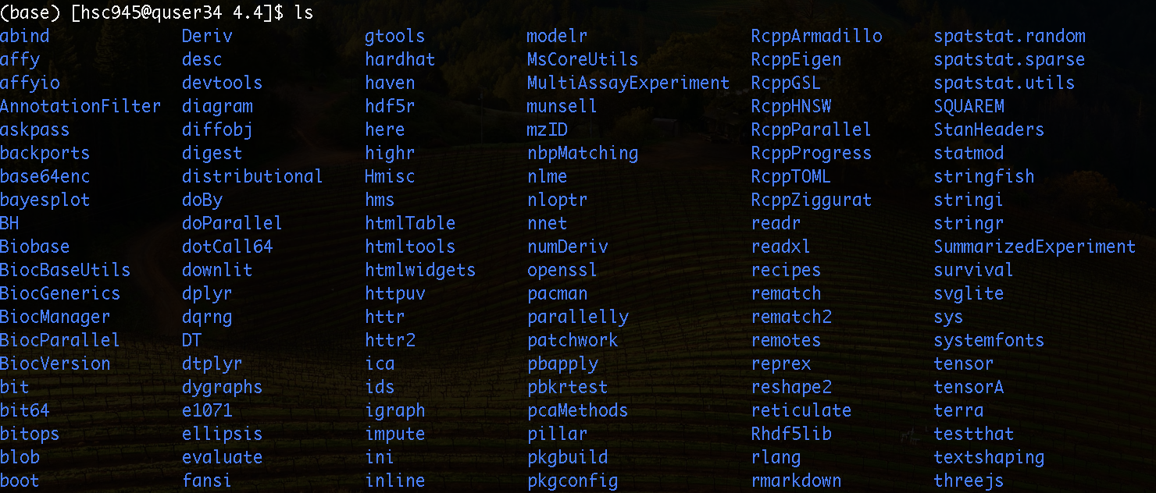
Let’s take a look!
cd /home/<netid>/R/x86_64-pc-linux-gnu-library/4.4
ls
You can also look in x86_64-pc-linux-gpu-library for other R versions and the packages you’ve installed for them.

Slide 13
Why might having one 4.4 folder for packages be a problem?
different versions of packages may not be compatible
different version of the same package might have different syntax
you may work on projects that need different packages with the same version of R
you may upgrade from R/4.4.0 to R/4.4.1 and find compatibility issues

Slide 14
What is the solution?
All package manager systems are basically making separate folders for each environment.
You can manually make different folders for different projects.
You can use Renv to control R package environments.
You can use mamba to create software environments for R or many other pieces of software.

Slide 15
What is the solution?
All package manager systems are basically making separate folders for each environment.
You can manually make different folders for different projects.
You can use Renv to control R package environments.
You can use mamba to create software environments for R or many other pieces of software.
Note: We will cover 1 and 3 today, not because 2 isn’t a good option but because of what we have experience with and because 3 can be useful beyond R for software environments on Quest.

Slide 16
Specify a custom location for packages.
In terminal:
cd <your folder in our classroom allocation>
mkdir R_packages
In R:
.libPaths(“/projects/e32559/<your folder>/R_packages”)
.libPaths() # should see new folder on top
Note: If you click from the “Files” to the “Packages” tab in the lower right hand window you can see what’s available change as you change .libPaths().

Slide 17
Install packages
install.packages("BiocManager")
# you can see this in your folder when it’s done
BiocManager::install("SingleCellExperiment")
# this will take a while, so let it run. It also installs all dependent packages because we’re starting from an almost empty folder.
BiocManager::install("scater")
BiocManager::install("OSCA.intro")

Slide 18

BiocManager installs from Bioconductor
Bioconductor is a repository, like CRAN
hosts R packages for bioinformatics
has its own semi-solution for version control:
specific versions of BiocManager tied to specific version of R
specific versions of each package tied to each version of BiocManager
https://www.bioconductor.org/

Slide 19
Install packages
install.packages("BiocManager”)
BiocManager::install("SingleCellExperiment")
# now should have many more R packages in install folder
# load the functions from SingleCellExperiment with
library(SingleCellExperiment)

Slide 20
Virtual environments for R and beyond
mamba allows you to build software environments with more functionality than just a separate folder
great for version control, and checking compatibility when you want to add something new
exportable so others on the same system can copy your environment
In the terminal:
module load mamba/24.3.0

Slide 21
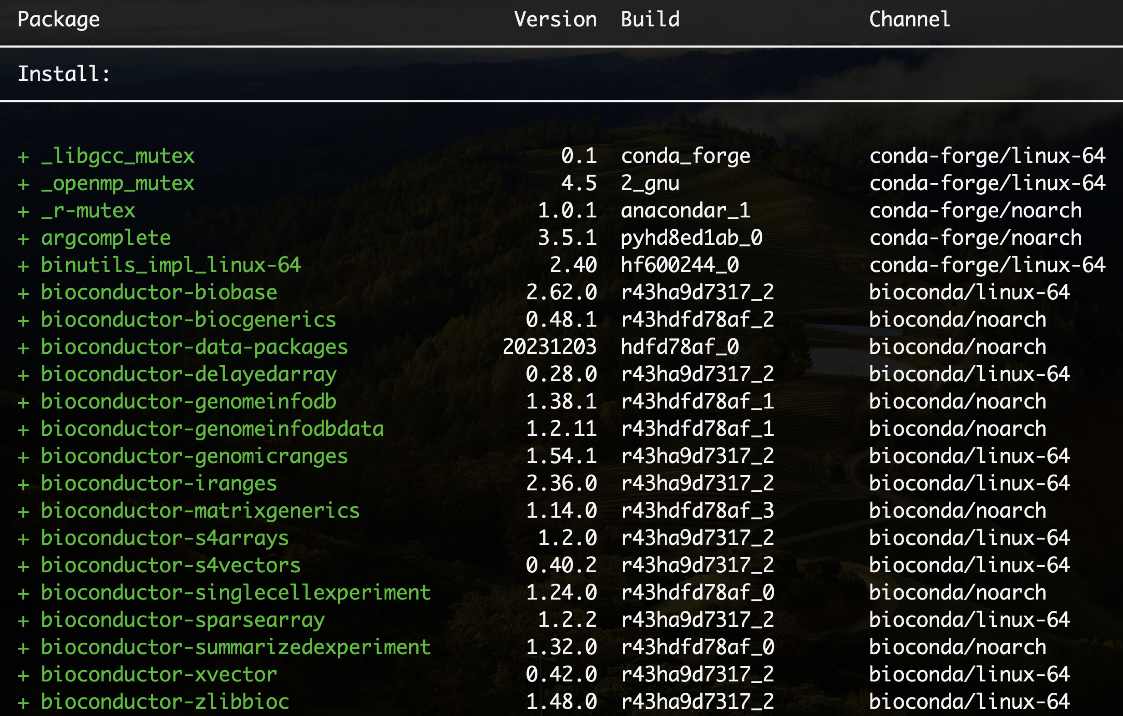
mamba create --name scexp -c conda-forge -c bioconda bioconductor-singlecellexperiment
If you scroll down, you’ll see this list also includes r-base (which is R) as well as other R packages.
Hit Y and then enter.
This will also take a while, be patient.

Slide 22
Using a virtual environment with QOD
Select to use a virtual environment with RStudio Server
This will remove the modules, as everything should be in the environment.
Change the job name so you can keep track!

Slide 23
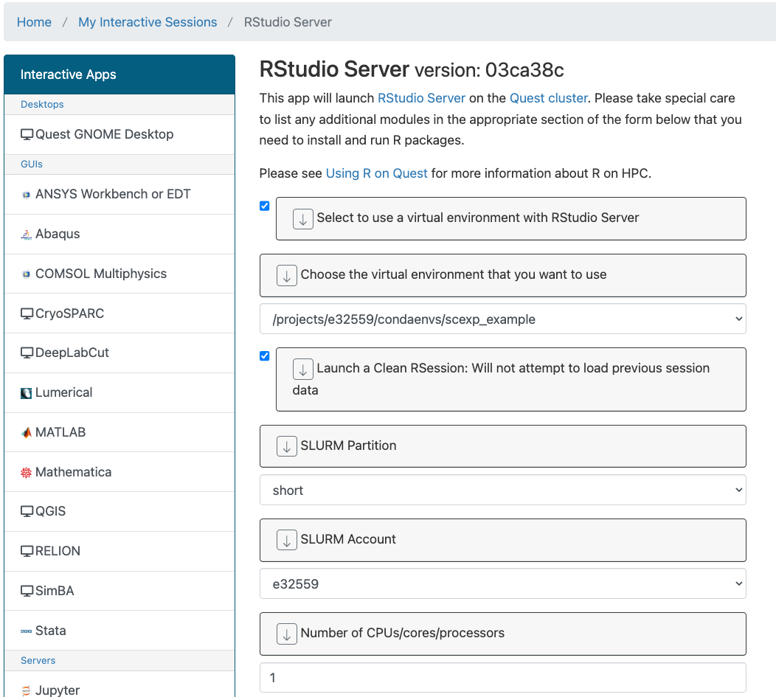
Using a virtual environment with QOD
Select to use a virtual environment
You will only see environments you created, even though they are in a shared folder.

Slide 24
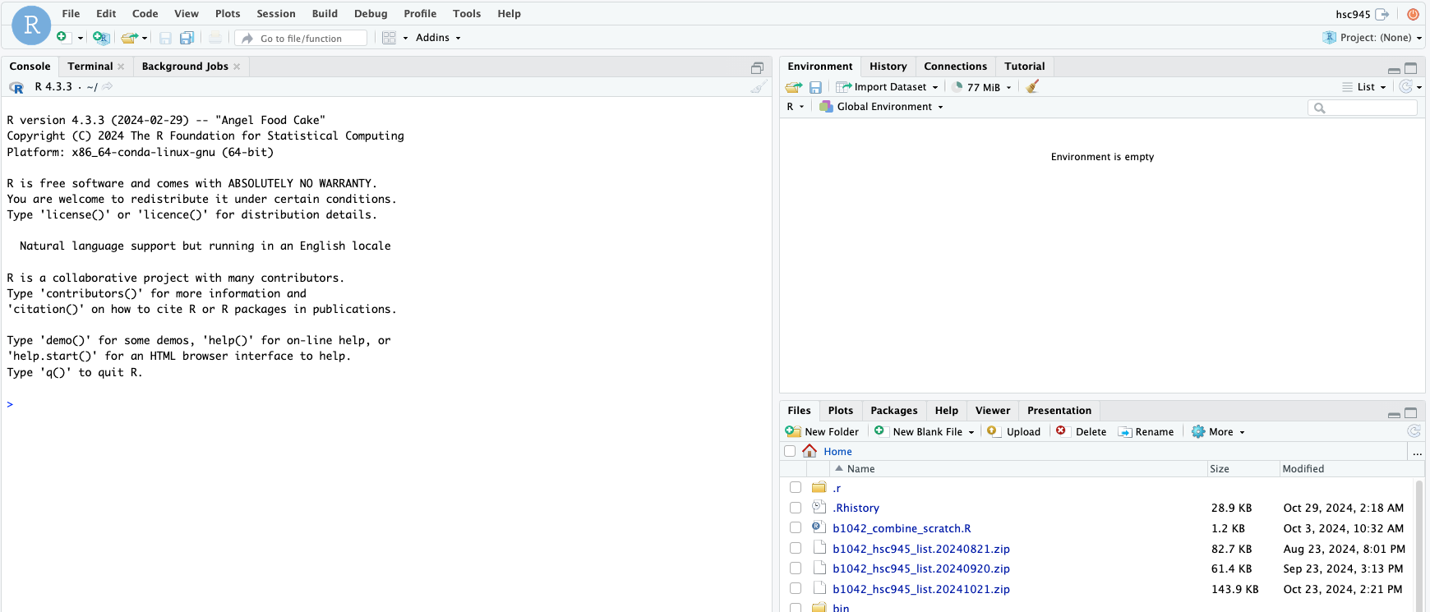

Slide 25
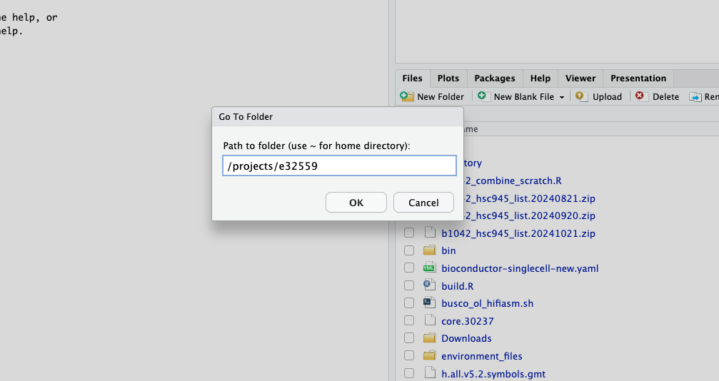

Slide 26
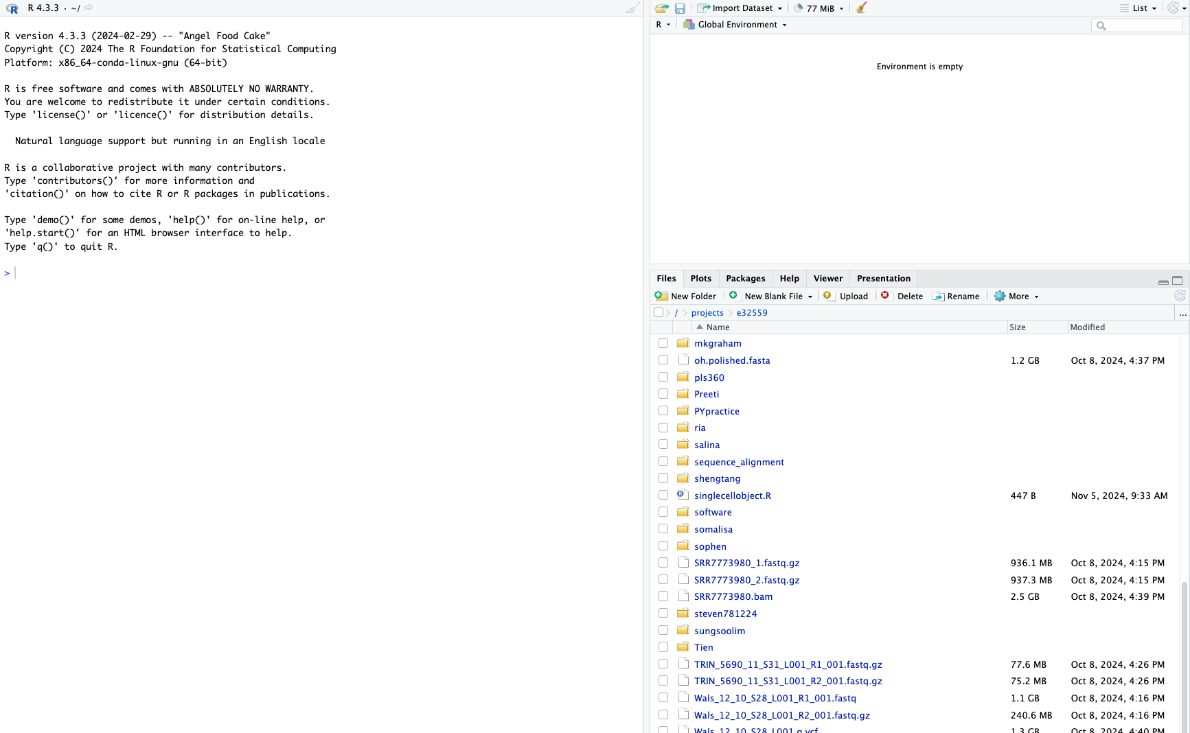
You should be able to open and execute the example code in this file now with your virtual environment. If you’d like to learn more about this example, it was taken from a SingleCellExperiment vignette: https://www.bioconductor.org/packages/release/bioc/vignettes/SingleCellExperiment/inst/doc/intro.html

Slide 27
To use this environment with Jupyter we would need to add one more thing...
source activate /home/<netid>/.conda/envs/scexp
mamba install -c conda-forge jupyter r-irkernel
R -e “IRkernel::installspec(name=‘scexp’, displayname=‘Rscexp’)”

Slide 28
More resources
Youtube video on installing R packages generally: https://www.youtube.com/watch?v=GM6MCBkVNtQ
Bioconductor website: https://www.bioconductor.org/
Quest Knowledge Base article on troubleshooting R installs: https://services.northwestern.edu/TDClient/30/Portal/KB/ArticleDet?ID=1834
Quest Knowledge Base article on using R on Quest: https://services.northwestern.edu/TDClient/30/Portal/KB/ArticleDet?ID=1556#:~:text=R%20packages%20intended%20for%20use,the%20details%20for%20further%20assistance.

